Slide 1
A Study on Model Pruning and Quantization Algorithms
Based on CIFAR-10 and VGG Network
Lin Xiaotao / Teng Yiduo / Wang Congyi / Zhang Ruijie / Yao Yang

Slide 2
1 Introduction
2 Methodology
3 Implementation
4 Conclusion
Contents
Master of Science in Artificial Intelligence
STAT 7008 Programming for Data Science
2023-24 Semester 1 Group Project
Topic 06 - Model Compression
December 3, 2023

Slide 3

01
Introduction
References Refline
[1] Cheng, Y., Wang, D., Zhou, P., & Zhang, T. A survey of model compression and acceleration for deep neural networks; [2] Cheng, J., Wang, P. S., Li, G., Hu, Q. H., & Lu, H. Q. Recent advances in efficient computation of deep convolutional neural networks; [3] He, K., Zhang, X., Ren, S., & Sun, J. Deep residual learning for image recognition; [4] Deng, Y. Deep learning on mobile devices: a review.

Slide 4
Description
- Most of the neural networks are computationally expensive and memory intensive
- Their deployment in devices with low memory resources or in applications with strict latency requirements is hindered
- Network pruning and quantization compress the models without significantly decreasing their performance

Slide 5
Ideas and Structure
- CIFAR-10 dataset as benchmark
- VGG network as base model
- Qualitatively and quantitatively evaluate the impact of the two methods on model size (memory, number of layers, etc.) and model performance (inference speed, accuracy, etc.)

Slide 6
02
Methodology
References Refline
[1] Liu, Z., Sun, M., Zhou, T., Huang, G., & Darrell, T. Rethinking the value of network pruning; [2] Molchanov, P., Tyree, S., Karras, T., Aila, T., & Kautz, J. Pruning convolutional neural networks for resource efficient inference; [3] He, Y., Liu, P., Wang, Z., Hu, Z., & Yang, Y. Filter pruning via geometric median for deep convolutional neural networks acceleration; [4] Luo, J. H., Wu, J., & Lin, W. Thinet: A filter level pruning method for deep neural network compression; [5] Liu, Z., Li, J., Shen, Z., Huang, G., Yan, S., & Zhang, C. Learning efficient convolutional networks through network slimming; [6] Meng, F., Cheng, H., Li, K., Luo, H., Guo, X., Lu, G., & Sun, X. Pruning filter in filter.

Slide 7

Pruning Algorithm
What is pruning?

Slide 8
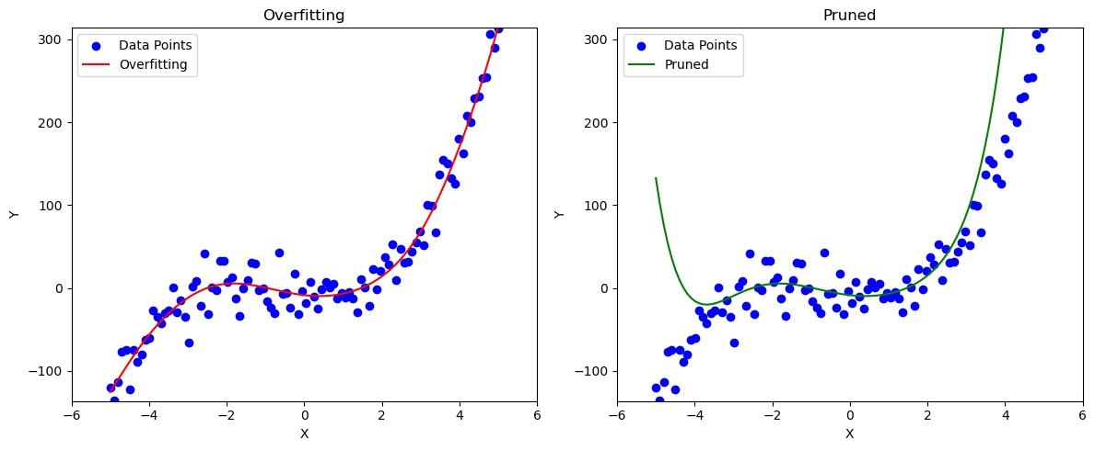
Pruning Algorithm
Overfitted Polynomial Equation
Pruned Equation

Slide 9
Pruning Process
Training
Pruning
Fine-tuning

Slide 10
Classification of Pruning
- Unstructured Pruning
Randomly pruning independent weights or neural connections
- Structured Pruning
Pruning filters/channels/layers
Layer-level
Channel-level
Filter-level

Slide 11

L1-Norm Unstructured Pruning
Network
Evaluate importance of neurons
Remove the least important neuron
Fine-tuning
Continue pruning?
NO
Stop pruning
YES

Slide 12
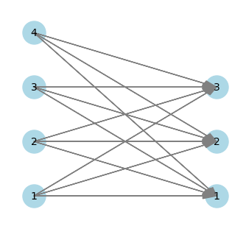
Example
- L1-norm unstructured pruning base on fully connected layers
Weight matrix
Pruning matrix
features
1 | -2 | -0.1
-0.2 | 3 | 0.2
-2 | 3 | 0.2
-2 | 0.1 | 3
0 | -2 | 0
0 | 3 | 0
-2 | 3 | 0
-2 | 0 | 3
neurons
prune_ratio = 0.5
Threshold = np.percentile(np.abs(matrix), prune_ratio * 100)
Threshold: 1.5000000000000000000000000000000000000000000000000
pruned_matrix = np.where(np.abs(matrix) < threshold, 0, matrix)

Slide 13
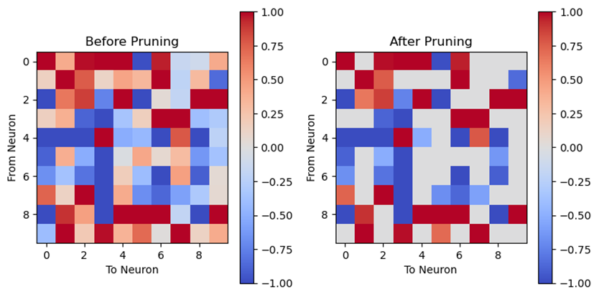
A Visualization Result for L1 norm UP

Slide 14
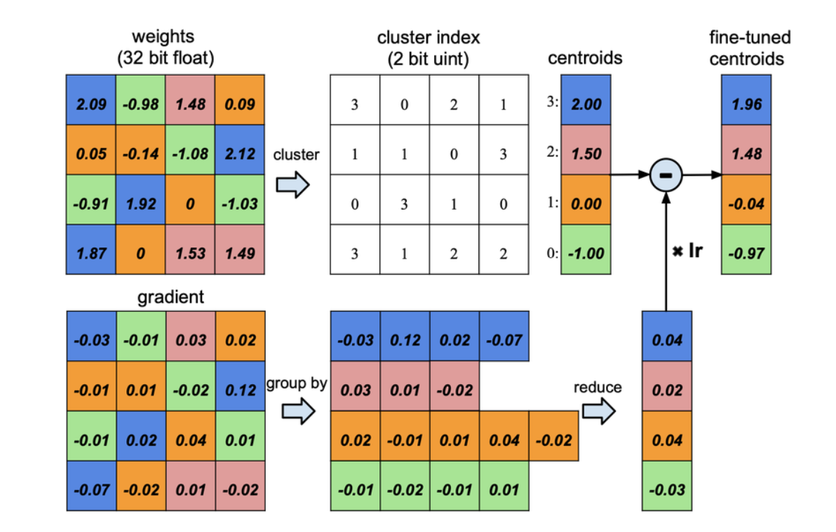
Quantization Algorithm
Advantages
- Parameter Compression
- Speed Enhancement
- Memory Reduction
Disadvantages
- Model Accuracy Decline

Slide 15
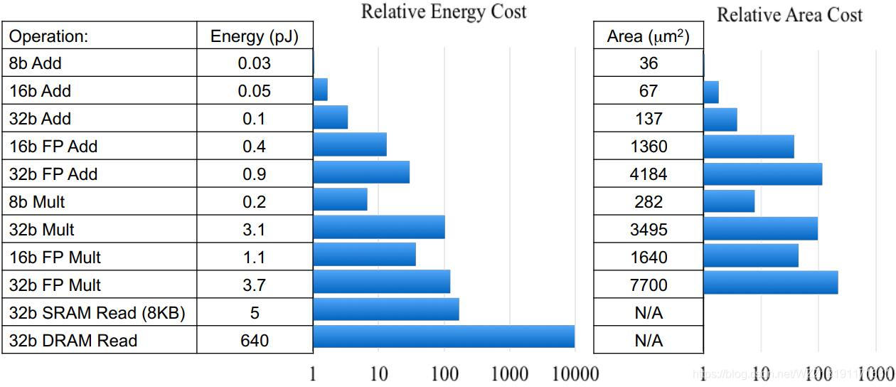
Quantization Algorithm
Advantages
- Parameter Compression
- Speed Enhancement
- Memory Reduction
Disadvantages
- Model Accuracy Decline

Slide 16
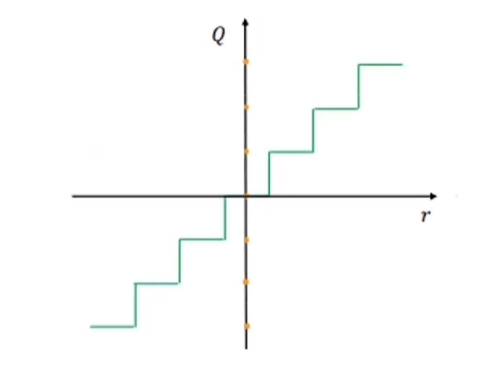
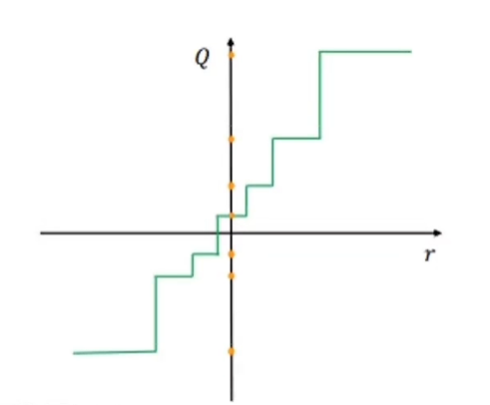

Quantization Algorithm
Linear and Non-linear Quantization
- whether the original data range represented by quantized data is uniform.
Linear

Slide 17
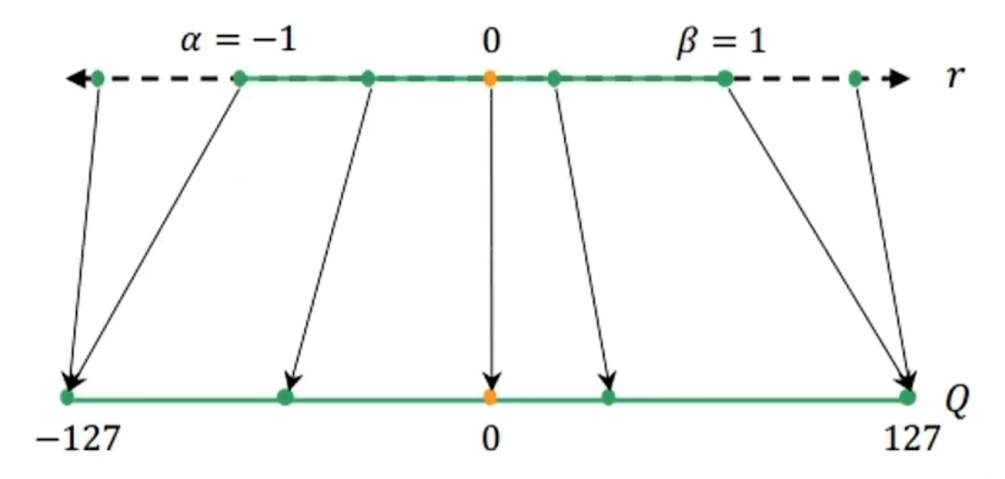
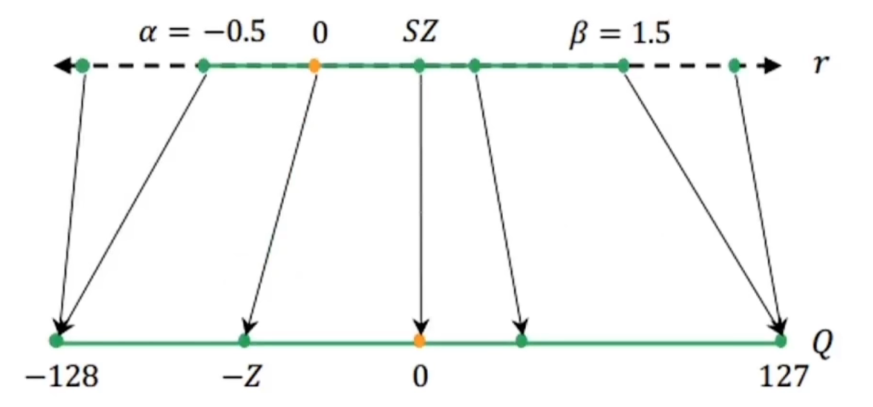

Quantization Algorithm
Symmetric and Asymmetric Quantization
- whether the zero point of floating-point values is mapped to the zero point of quantized values.
Asymmetric

Slide 18
Quantization Algorithm
Granularity of Quantization
- per-layer: all filters share the same quantization parameters
- per-channel: parameters are individually calculated for each filter
Precision Selection
- Uniform Precision: same bit-width among layers
- Mixed Precision: different bit-widths among layers

Slide 19
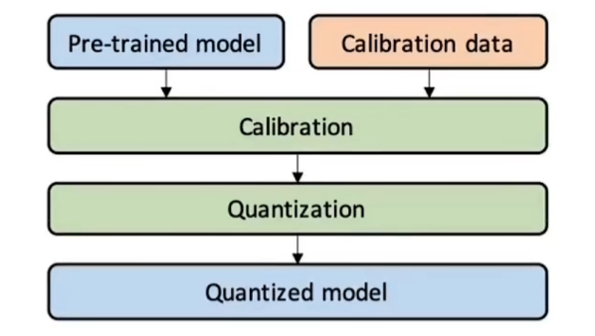
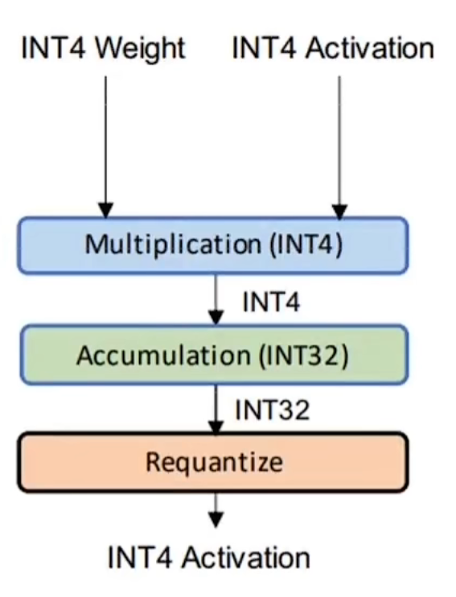
Quantization Algorithm
- applies quantization to a pre-trained model
- weight quantization
- full quantization (Weights and activation values)
Static Quantization
- precomputed offline and remain fixed
Dynamic Quantization
- computed during the inference phase

Slide 20
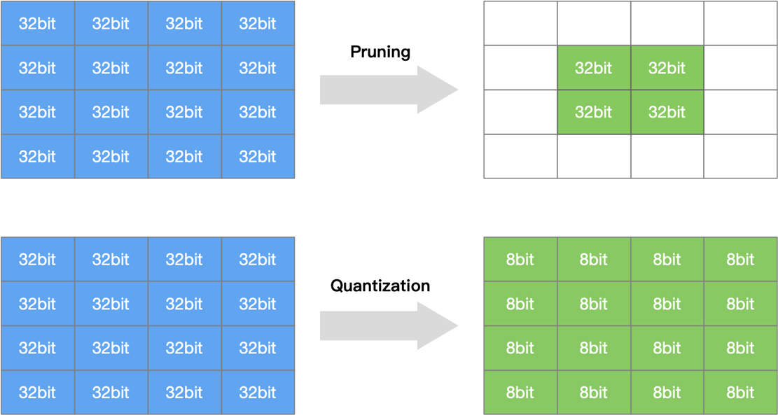
Pruning and Quantification Comparison
- Model pruning: attempts to remove/prun redundant and non-critical weights.
- Model quantization: reduces the number of bits required for weight representation or activation.

Slide 21
03
Implementation
References Refline
[1] Krizhevsky, A., & Hinton, G. Learning multiple layers of features from tiny images.

Slide 22
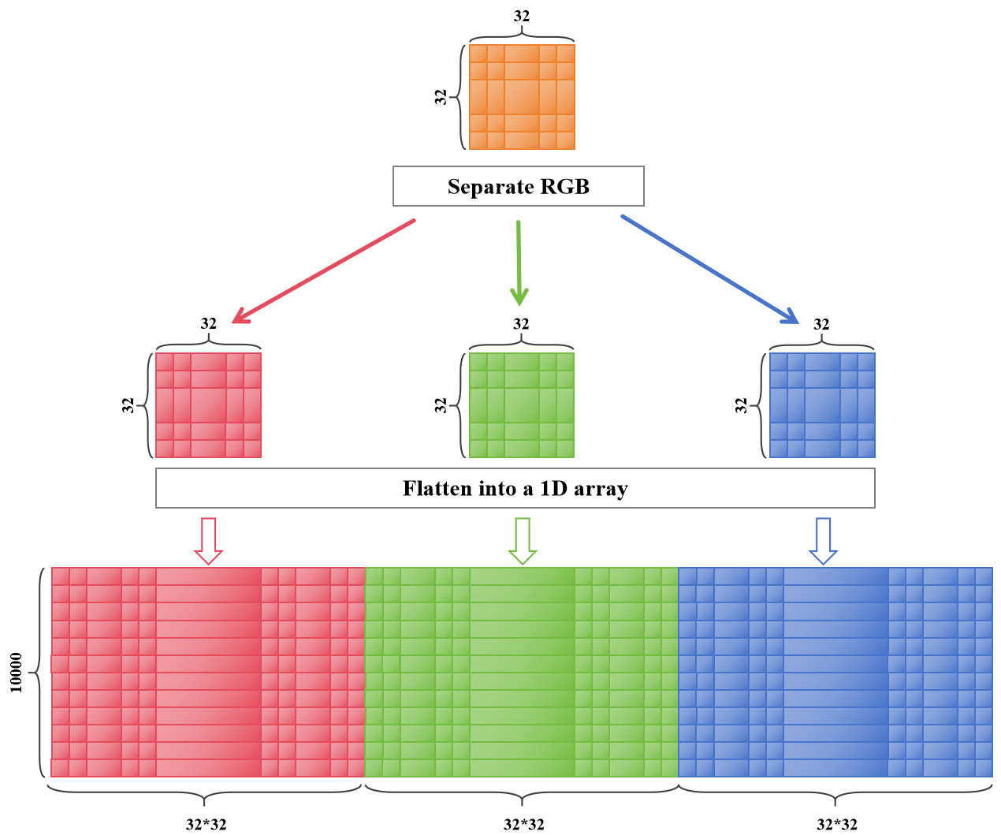
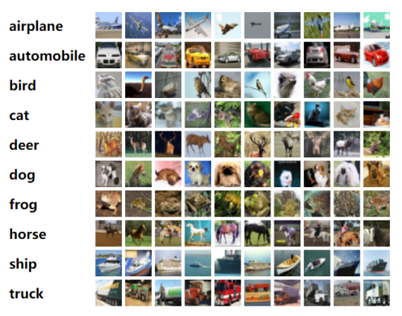
CIFAR-10 Dataset

Slide 23
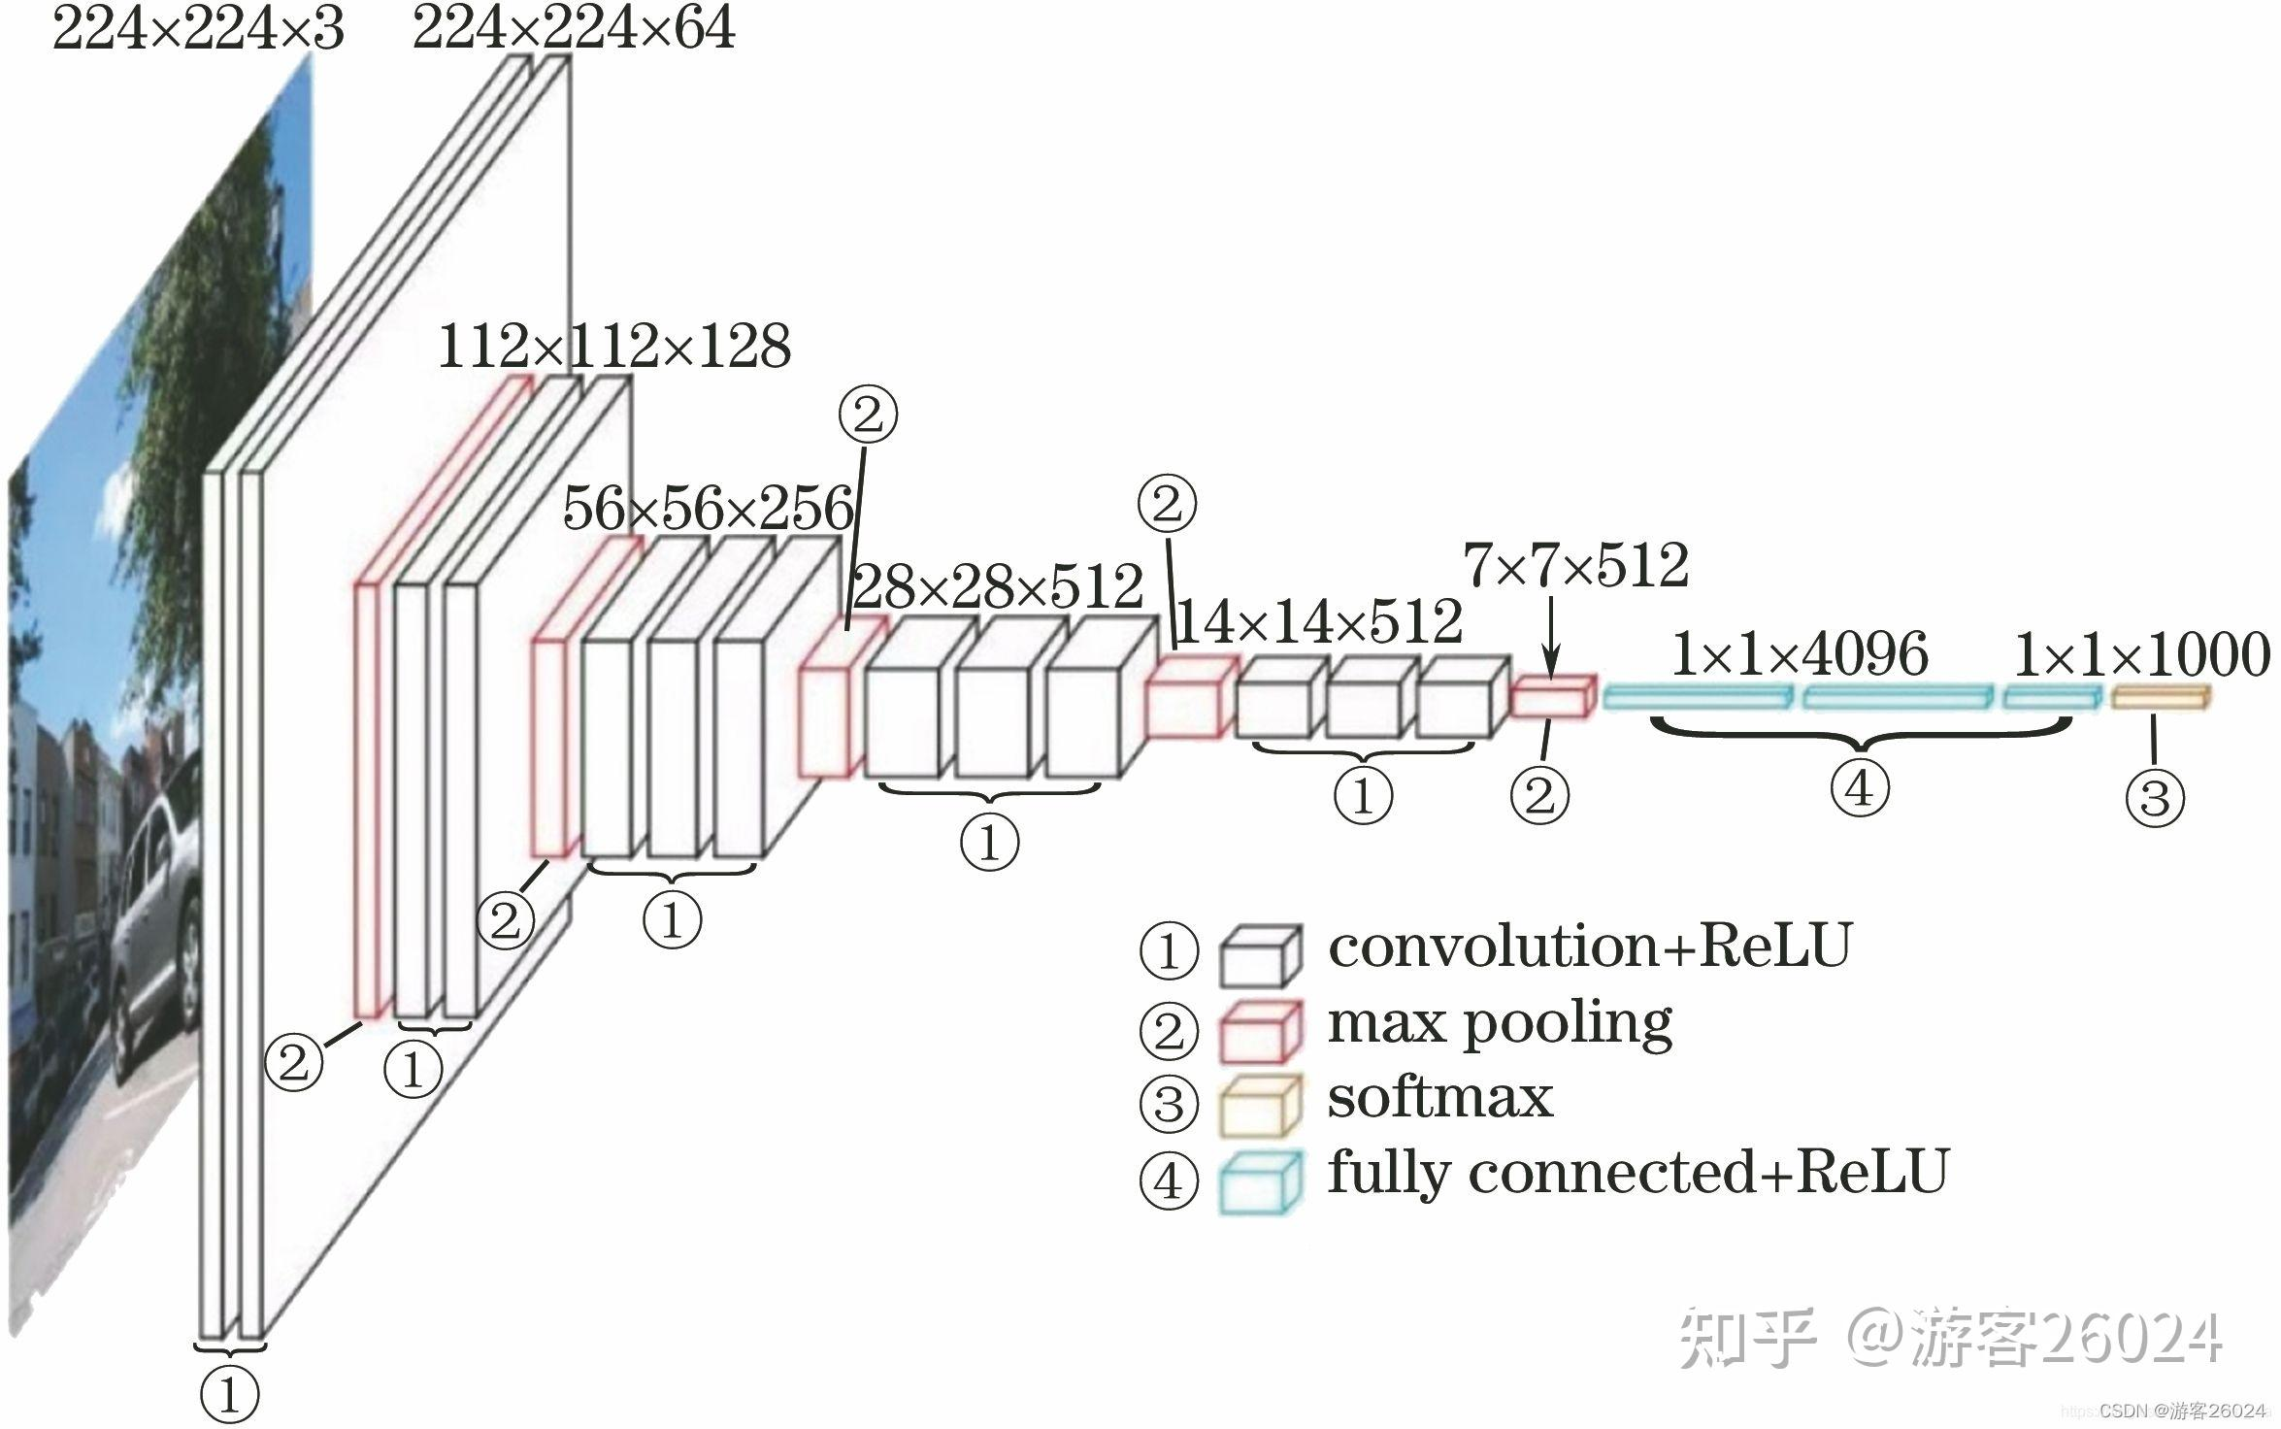
VGG-16 Network Base model
- 16 convolutional layers
- 3 fully connected layers
Time-consuming with limited computational resources

Slide 24
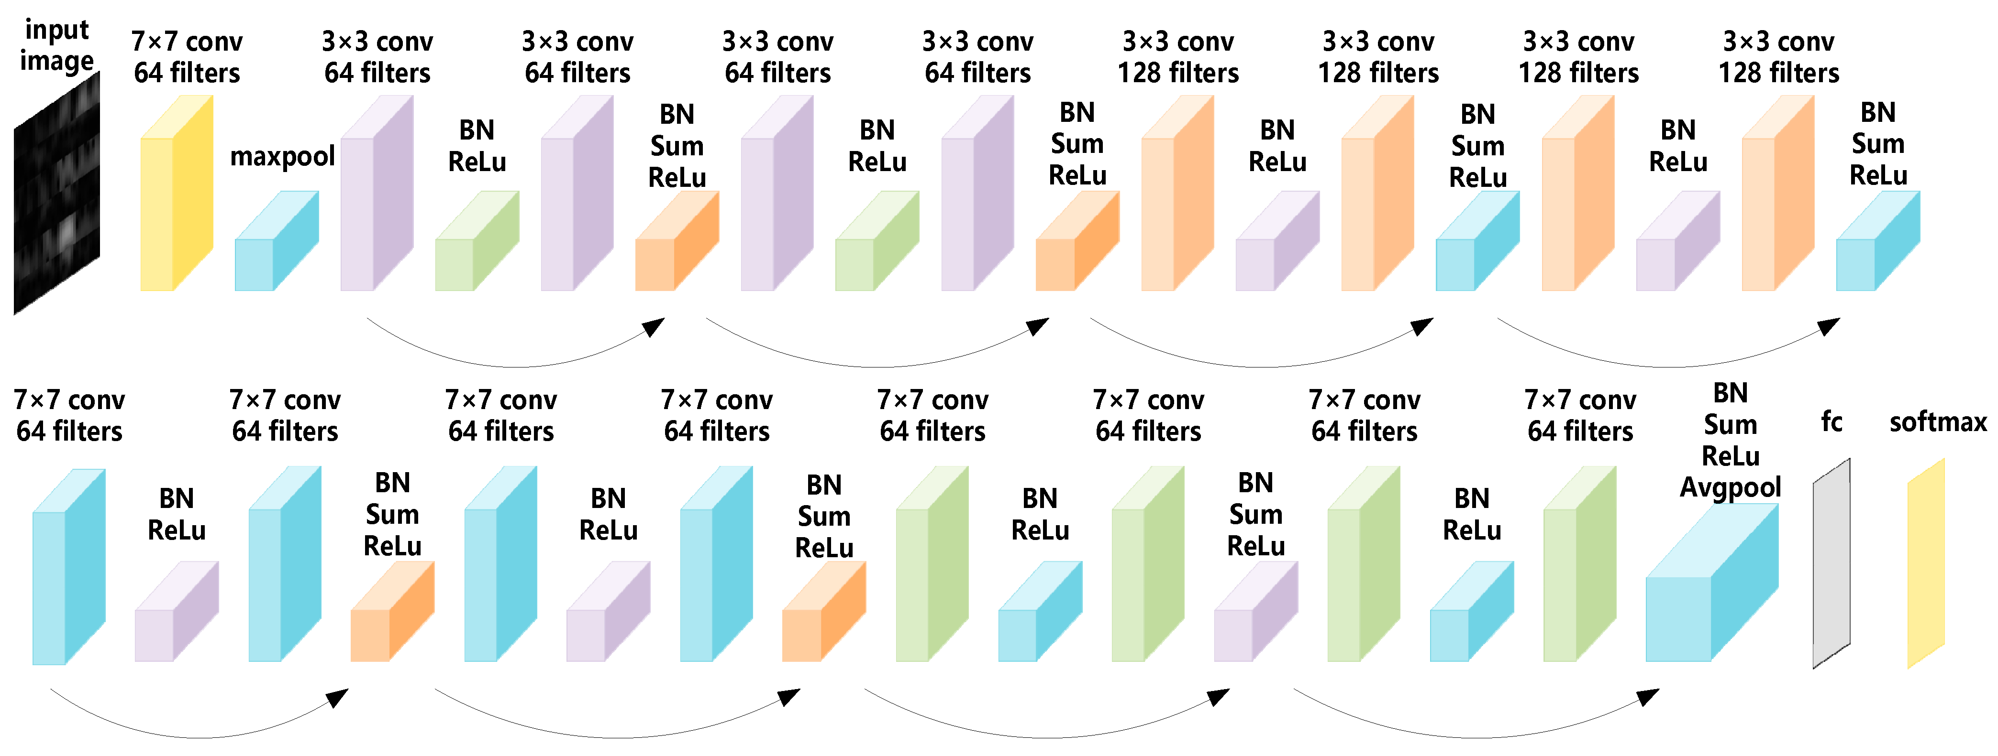
ResNet-18 Network Base Model

Slide 25
Model Pruning
10%
30%
L1_unstructured
50%
70%
90%

Slide 26
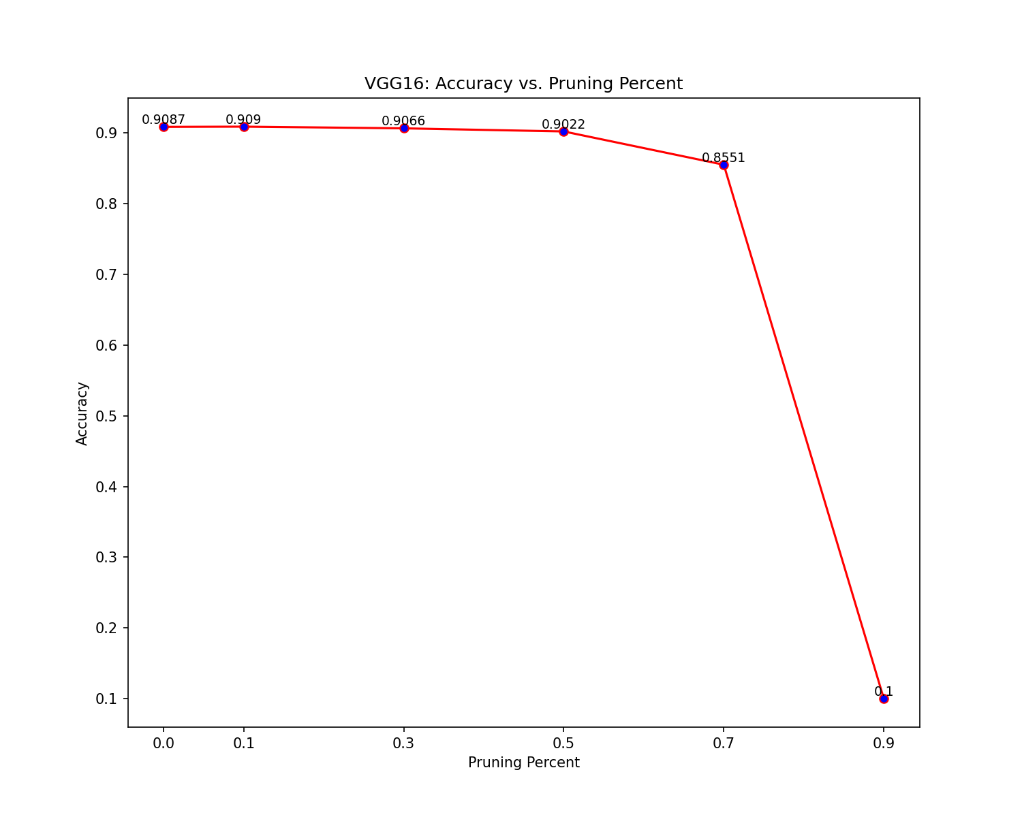
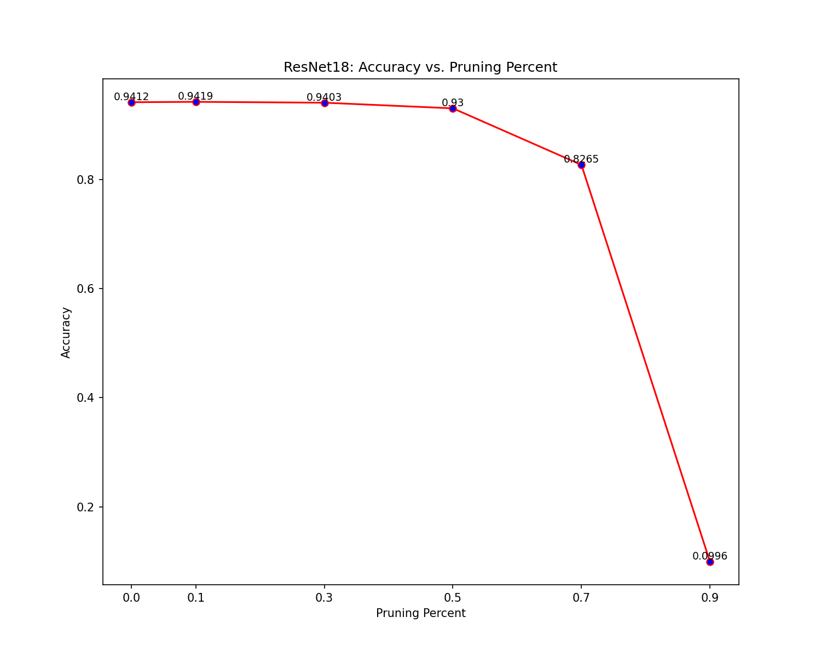
Quantitative Analysis: Pruning
VGG16
ResNet18

Slide 27
Quantization: Target Model
Resnet-18
VGG-16
image
image
Uniformity
Residual
3x3, Cov
3x3, Cov
×13
×8
3x3, Cov
Ignore pooling and batch norm
3x3, Cov
FC
×3
Avg pool
FC

Slide 28
Quantization: Post Training
Static quantization
- Merge layers
- Config setting (qnnpack)
Histogram Observer (activation)
Min Max Observer
- Insert Observer
- Get distributional characteristics
- Before inference
Quantization and de-quantization
Dynamic quantization
- Reduced precision (int8)
- Reduced target
Linear
- Min Max Observer (weight)
min_val，max_val
qmin, qmax
- Tensor-wise

Slide 29
Quantitative Analysis: Quantization
 | VGG-16 |  |  |  | Resnet-18
 | Before | Static | Dynamic | 0.5 prun | Before | Static | Dynamic | 0.5 prun
Size (mb) | 527.81 | 132.01 | 174.09 | 263.90 | 42.73 | 10.79 | 42.76 | 21.36
Accuracy (%) | 91.22 | 90.99 | 91.25 | 90.22 | 94.15 | 93.94 | 94.63 | 93.01
CPU time (%) | 100.0 | 43.62 | 74.98 | 97.79 | 100.00 | 34.58 | 71.48 | 103.09

Slide 30
04
Conclusion
References Refline
[1] Choudhary, T., Mishra, V., Goswami, A., & Sarangapani, J. A comprehensive survey on model compression and acceleration; [2] Cheng, J., Wang, P. S., Li, G., Hu, Q. H., & Lu, H. Q. Recent advances in efficient computation of deep convolutional neural networks; [3] Sainath, T. N., Kingsbury, B., Sindhwani, V., Arisoy, E., & Ramabhadran, B. Low-rank matrix factorization for deep neural network training with high-dimensional output targets; [4] Hinton, G., Vinyals, O., & Dean, J. (2015). Distilling the knowledge in a neural network.

Slide 31
Summary
- Explained the ideas and working principles of the two algorithms
- Selected CIFAR-10 as the benchmark and VGG network as the baseline, and compared the two compression algorithms with the base
- Qualitatively and quantitatively analyzed the performance of the two algorithms
- Both of the model compression algorithm achieved the goal
- Quantization performed better than pruning

Slide 32
Limitations and Improvements
- Self-adaptive compression: achieve automatic adaptation and decision-making by adjusting some hyperparameters
- Quantization during training: design methods to quantify the network during training based on new optimization algorithms
- Unsupervised compression: design unsupervised methods
- On-demand compression: model should perform targeted on-demand compression to achieve maximum resource utilization

Slide 33
Scenarios Discussion
Quantization
- Resource-constrained devices
- Real-time applications
- Large scale deployment
Pruning
- Model explanatory
- Avoiding overfitting
- Accelerate training process

Slide 34
Other Compression Methods
- Low-rank factorization: low-rank factorization reduces the number of parameters and improves the speed-up
- Knowledge distillation: by transferred the knowledge acquired by the cumbersome model to a smaller model, we can make deployment easier

Slide 35
The End
Lin Xiaotao / Teng Yiduo / Wang Congyi / Zhang Ruijie / Yao Yang

